Slide 1
Mathematical analysis of network telescope traffic for automated security metric generation
Bradley Cowie
Supervised by Barry Irwin
Security and Networks Research Group
Department of Computer Science
Rhodes University

Slide 2
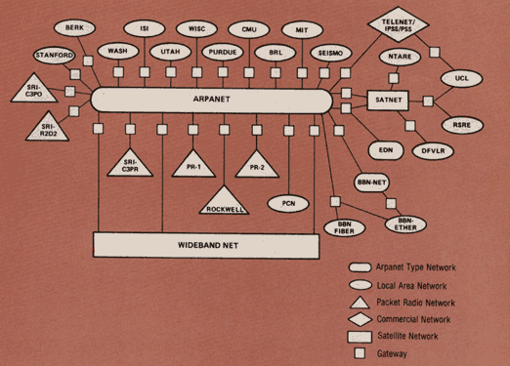
Outline
Outline
Foreword
Introduction
Problem Statement
Background
Network Telescopes
Security Metrics
Artificial Intelligence
Related Work
Approach
Data Summarization
Measuring Normality
Manual Incident Identification
Constructing Training Data
(modeling)
Future Work
Recap
Questions and Comments
Map of the “Internet” circa 1983.
Notes:
In January, the ARPANET standardizes on the TCP/IP protocols adopted by the Department of Defense (DOD). DOD splits the network into a public ‘ARPANET’ and a classified ‘MILNET, ‘ with only 45 hosts remaining on the ARPANET.

Slide 3
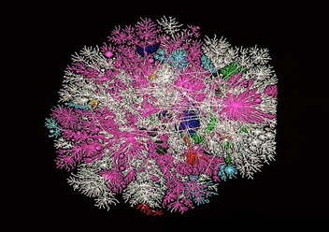
Foreword
Foreword
“Fundamental characteristics of the Internet are perpetually challenging to research and analyze, and we must admit we know little about what keeps the system stable. As a result, researchers and policy makers currently analyze what is literally a trillion-dollar ecosystem [the Internet] essentially in the dark, and agencies charged with infrastructure protection have little situational awareness regarding global dynamics and operational threats”
From : Internet Mapping: from Art to Science by K. Claffy, Y. Hyun et. al. (CAIDA)
Graphic of global internet traffic. Each line represents the path of sample data sent out to one of 20,000 pre- selected locations using a system called Skitter. Developed during research at CAIDA

Slide 4
Introduction
Problem Statement
An enormous amount of network traffic is generated on a daily basis, requiring a significant analysis.
It is noted that while this sort of data is often logged, it is not often that it is closely considered.
ISPs/Organizations are interested in traffic that is anomalous relative to regular traffic received.
It would be useful if there were intelligent and automated techniques to identify “Network Incidents” in a vast amount of data in a relatively short period of time.

Slide 5
Background
Network Telescopes
The idea of a Network Telescope has been around for a number of years now (since about the early 2000’s)
Fundamentally, a (Passive) Network Telescope is assigned an area of IP Space on which there are no nodes.
This implies that all traffic received is either malicious or due misconfiguration (class this sort of traffic as anomalous)
Being passive implies that the TCP handshake cannot be completed.
This provides a window into the nature of events occurring on the Internet

Slide 6
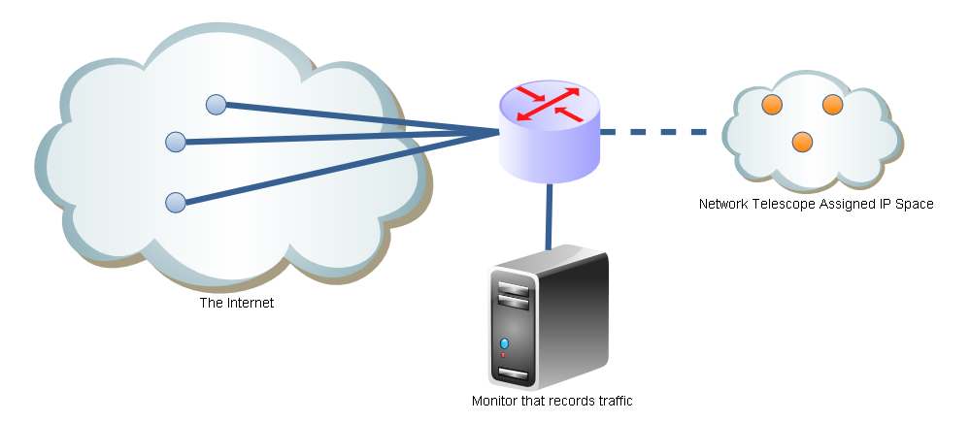
Background
Simple Network Diagram of a Network Telescope

Slide 7
Background
Network Telescopes
The IP Space allocated to a Network Telescope will determine the probability that it will receive packets.
Considering an unbiased algorithm that sends a packet to a completely random IP. The chance that a packet will arrive at a Telescope that has been allocated a Class A network space is 1/256.
A Class B Network Telescope has 1/65536 chance of receiving the packet.
This suggests the bigger the space the better, however it is still possible to observe incidents even in a small IP space.

Slide 8
Background
Security Metrics
A security metric is the analysis provided by considering some measurable quantity related to the security of a system.
Logs of the number of machines that have received and applied patches over a period of time provides a useful measure of the effectiveness of patching systems put in place by an organization’s IT department

Slide 9
Background
Security Metrics
When you can measure what you are speaking about, and express it in numbers, you know something about it; but when you cannot measure it, when you cannot express it in numbers, your knowledge is of a meager and unsatisfactory kind: it may be the beginning of knowledge, but you have scarcely, in your thoughts, advanced to the state of science.
William Thompson, Lord Kelvin, Popular Lectures and Addresses [1891-1894], in Bartlett's Familiar Quotations, Fourteenth Edition, 1968, p. 723a.

Slide 10
Background
Security Metrics
Not everything that can be counted counts, and not everything that counts can be counted.
Attributed to Albert Einstein
While the sage advice “you can’t manage what you can’t measure” (Drucker, 1993) is still very much true, in an e-Business environment it is also true that “you can’t measure what you can’t monitor”.
Drucker, P. (1993). The Practice of Management (Reissue edition). New York, NY: Harper Business.

Slide 11
Background
Artificial Intelligence
It is the science and engineering of making intelligent machines, especially intelligent computer programs. It is related to the similar task of using computers to understand human intelligence, but AI does not have to confine itself to methods that are biologically observable.
WHAT IS ARTIFICIAL INTELLIGENCE?, John McCarthy, Stanford University, 2007

Slide 12
Background
Potential techniques to be explored
Simple Neural Networks
Complex Neural Networks
Bayesian Networks
Genetic Algorithms (for rule optimization)
P₁
W₁
∑
F
P₂
W₂
P₃
W₃
B

Slide 13
Related Works
CAIDA
The Cooperative Association for Internet Data Analysis (CAIDA) is a research body that together with the American government, commercial interest and academic intuitions (UCSD). They have produced a lot of work relating to network telescopes and analysis including papers such as :
Internet Mapping: from Art to Science
Code-Red: a case study on the spread and victims of an Internet worm
A Day at the Root of the Internet
The Internet Measurement Data Catalog
A Robust System for Accurate Real-time Summaries of Internet Traffic: Technical Report
The Spread of the Witty Worm
Network Telescopes: Technical Report (fundamental reading in network telescopes)

Slide 14
Related Works
Other Work
There is large volume of work consisting of numerical and statistical analysis of the data entering and leaving a networks with the goal of this analysis to detect malicious activity. These models tend to be
Extremely heavy and complex
Fairly rigid
Consider a typical network (not data from a Network Telescope)
Generally aren’t implemented in the real world
Some of these techniques include
Classification of nodes allowing for statistical clustering (K - clustering)

Slide 15
Approach
Data Summarization
Reduces the data set into more manageable components from which more meaningful analysis can be made
A database of packet headers can be reduced into a number of numerical measures for a given time period.
Consider variations in measures at the yearly, monthly, quarterly, daily and hourly (maybe) level.
Types of measures :
Mean
Median
Sliding average
Standard deviation
Simple counts
Ratios

Slide 16
Approach
Data Summarization
“Interesting” measures relating to a network packet header :
Total Packet Count
Mean Packet Count
Median Packet Count
Standard Deviation in Packet Size
Counts by IP grouped at /24 /16 /8
Counts by Top Ports
Ratio by Top Ports etc.
“Sufficiently” large changes in these values we could assume that there has been a significant change in the composition of anomalous traffic on the Internet.
This may be indicative of a Network Incident.

Slide 17
Approach
Normality
It is important to measure “new” readings relative to a previously known norm.
This raises three key issues
How do we even begin to define what measures are appropriate to define normality of network traffic (and for a network telescope at that)
Previous normality may be skewed significantly by previous incidents
Normality may vary significantly depending on the time interval considered

Slide 18
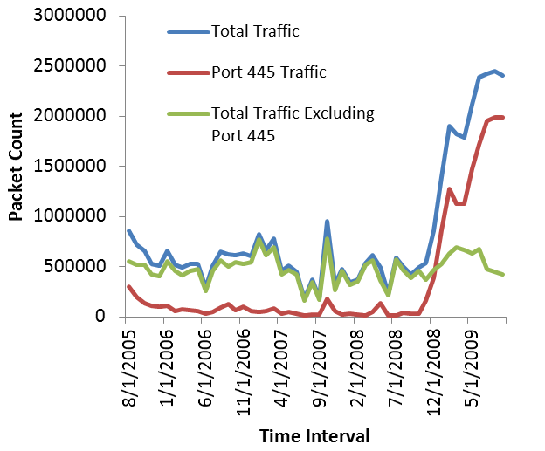
Approach
Normality

Slide 19
Approach
Normality

Slide 20
Approach
Resolution
The time interval that we choose to consider has a major effect on incident discovery.
If too large an interval is chosen (say a yearly scale) it is potentially difficult to discern individual incidents due to the “noise” caused by other incidents.
Also too large an interval is of little value to real-time analysis and monitoring.
Too small an interval requires a large amount of processing and analysis.

Slide 21
Approach
Constructing training data
In order to train Artificial Intelligence constructs, training data is required. In this context we need data with markings showing where known incidents have occurred. While there is a large amount of data is available, most/all of it is currently inappropriate to act as training data.
Three possible solutions to this problem may be considered.
Manually marking data sets by considering heuristics that point to possible network events. Confirm using trusted websites such as CERT.org and SANS.org
Creating simulated data sets using existing models of virus propagation and other modeling of other events such as DDoS
WebCrawler of trusted sites (challenging)

Slide 22
Approach
Manual Marking
As all of the data is already stored in a database, it is relatively easy to write queries to “manually” evaluate data in hopes of finding events.
This relies on being able to experimentally or theoretically derive useful “heuristics”/rules. When these rules are met or broken that an event has likely occurred.
Large variation in packet sizes (some viruses do this as a protection mechanism against filtering)
Change in Top Port Ratio of Total Traffic
Sudden increase in packet counts for a specific port

Slide 23
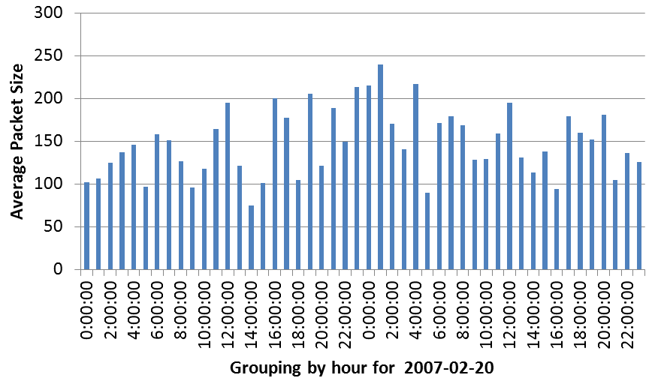
Approach
Variation in Packet Size -> Win32.Rinbot identification

Slide 24
Approach
Variation in Packet Size -> Win32.Rinbot identification

Slide 25
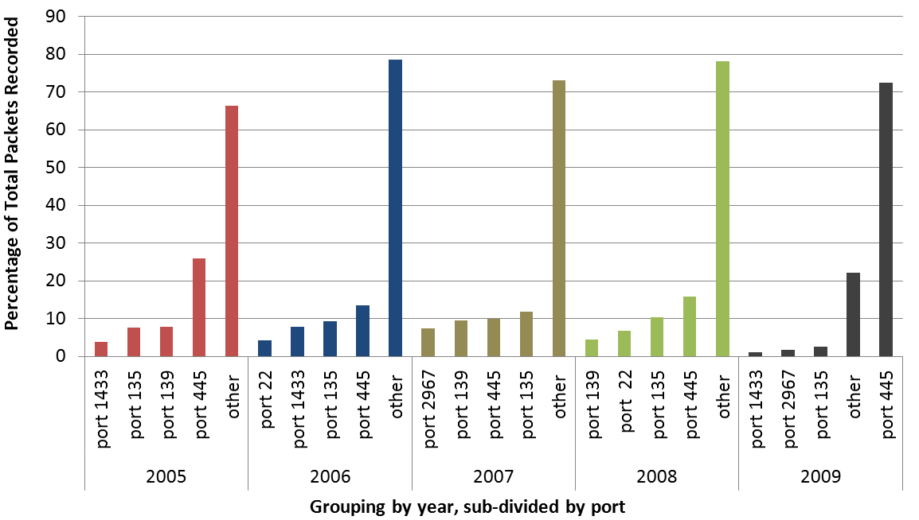
Approach
Variation in Top Ports as a ratio -> Conficker

Slide 26
Approach
Variation in Top Ports as a ratio -> Conficker

Slide 27
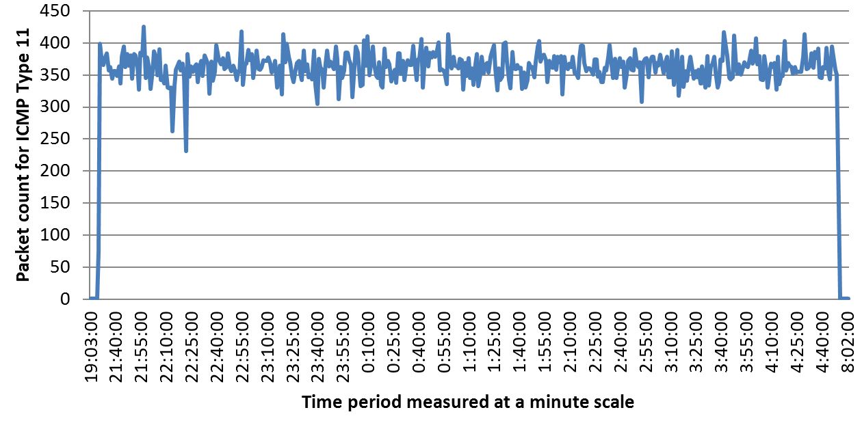
Approach
Sudden increase in packet count -> DDoS

Slide 28
Approach
Sudden increase in packet count -> DDoS

Slide 29
Approach
Automated Marking through Simulation
Using known models for Virus Propagation and modeling of malicious activity it is possible to generate marked sets of data that can be used for training.
This data should be perturbed appropriately as real events are likely to deviate from these models.
Logistic Growth
SIRS Model for virus propagation
DDoS Model
Probabilistic Model

Slide 30
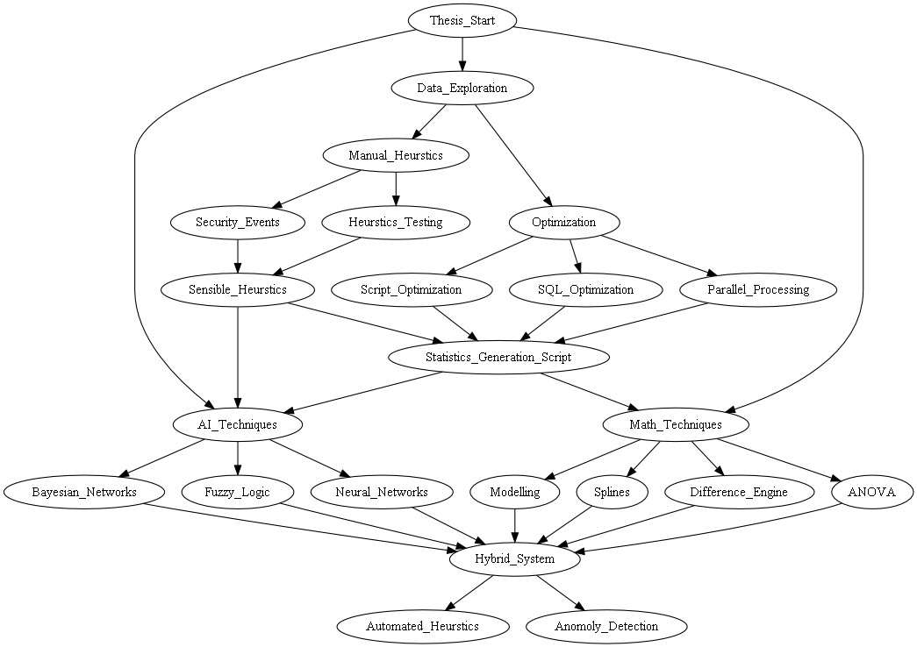
Scope
Early Project Scope

Slide 31
Scope
Possible shortcomings
Mostly limited to observing previous events or considering deviations in normality.
Relying on any sort of port analysis is becoming less useful due to the dynamic port range and attacks using random ports.
Due to the nature of incidents, modeling may not always provide a good representation of reality
Parsing large datasets is incredibly time consuming. Complex queries can take hours to run if not carefully considered.

Slide 32
Future Work
The future !
Next couple of months will involve mainly literature review and basic implementation.
Things I plan to investigate/do !
Build a large neural network for Network Incident Detection trained off simulated data
Manually mark datasets (for known incidents) to evaluate the effectiveness of the trained neural network
Consider a set of simplistic rules for incident identification. Using a GA maximize the number of incidents identified while minimizing the number of false-positives
Investigate other AI structures (Bayesian networks)

Slide 33
RECAP
RECAP
What am I doing ?
Using mathematical techniques such as artificial intelligence to aid in the identification of network incidents using Network Telescope data.
Why ?
There is too much data to reliably perform manual analysis
This sort of information is important to people who need to make high level management decisions
The Internet is a complex system and further research is required ☺
How ?
Using modeling techniques to simulate training data sets
Manual marking to build data sets for evaluation
Constructing artificial intelligence structures for identification
Exploring mathematical techniques that provide possible solutions

Slide 34
Questions
Questions and comment ?

Slide 35
Questions
Comments on the quality of the presentation ?
What did I do wrong ?
What did I do right ?

